Slide 1
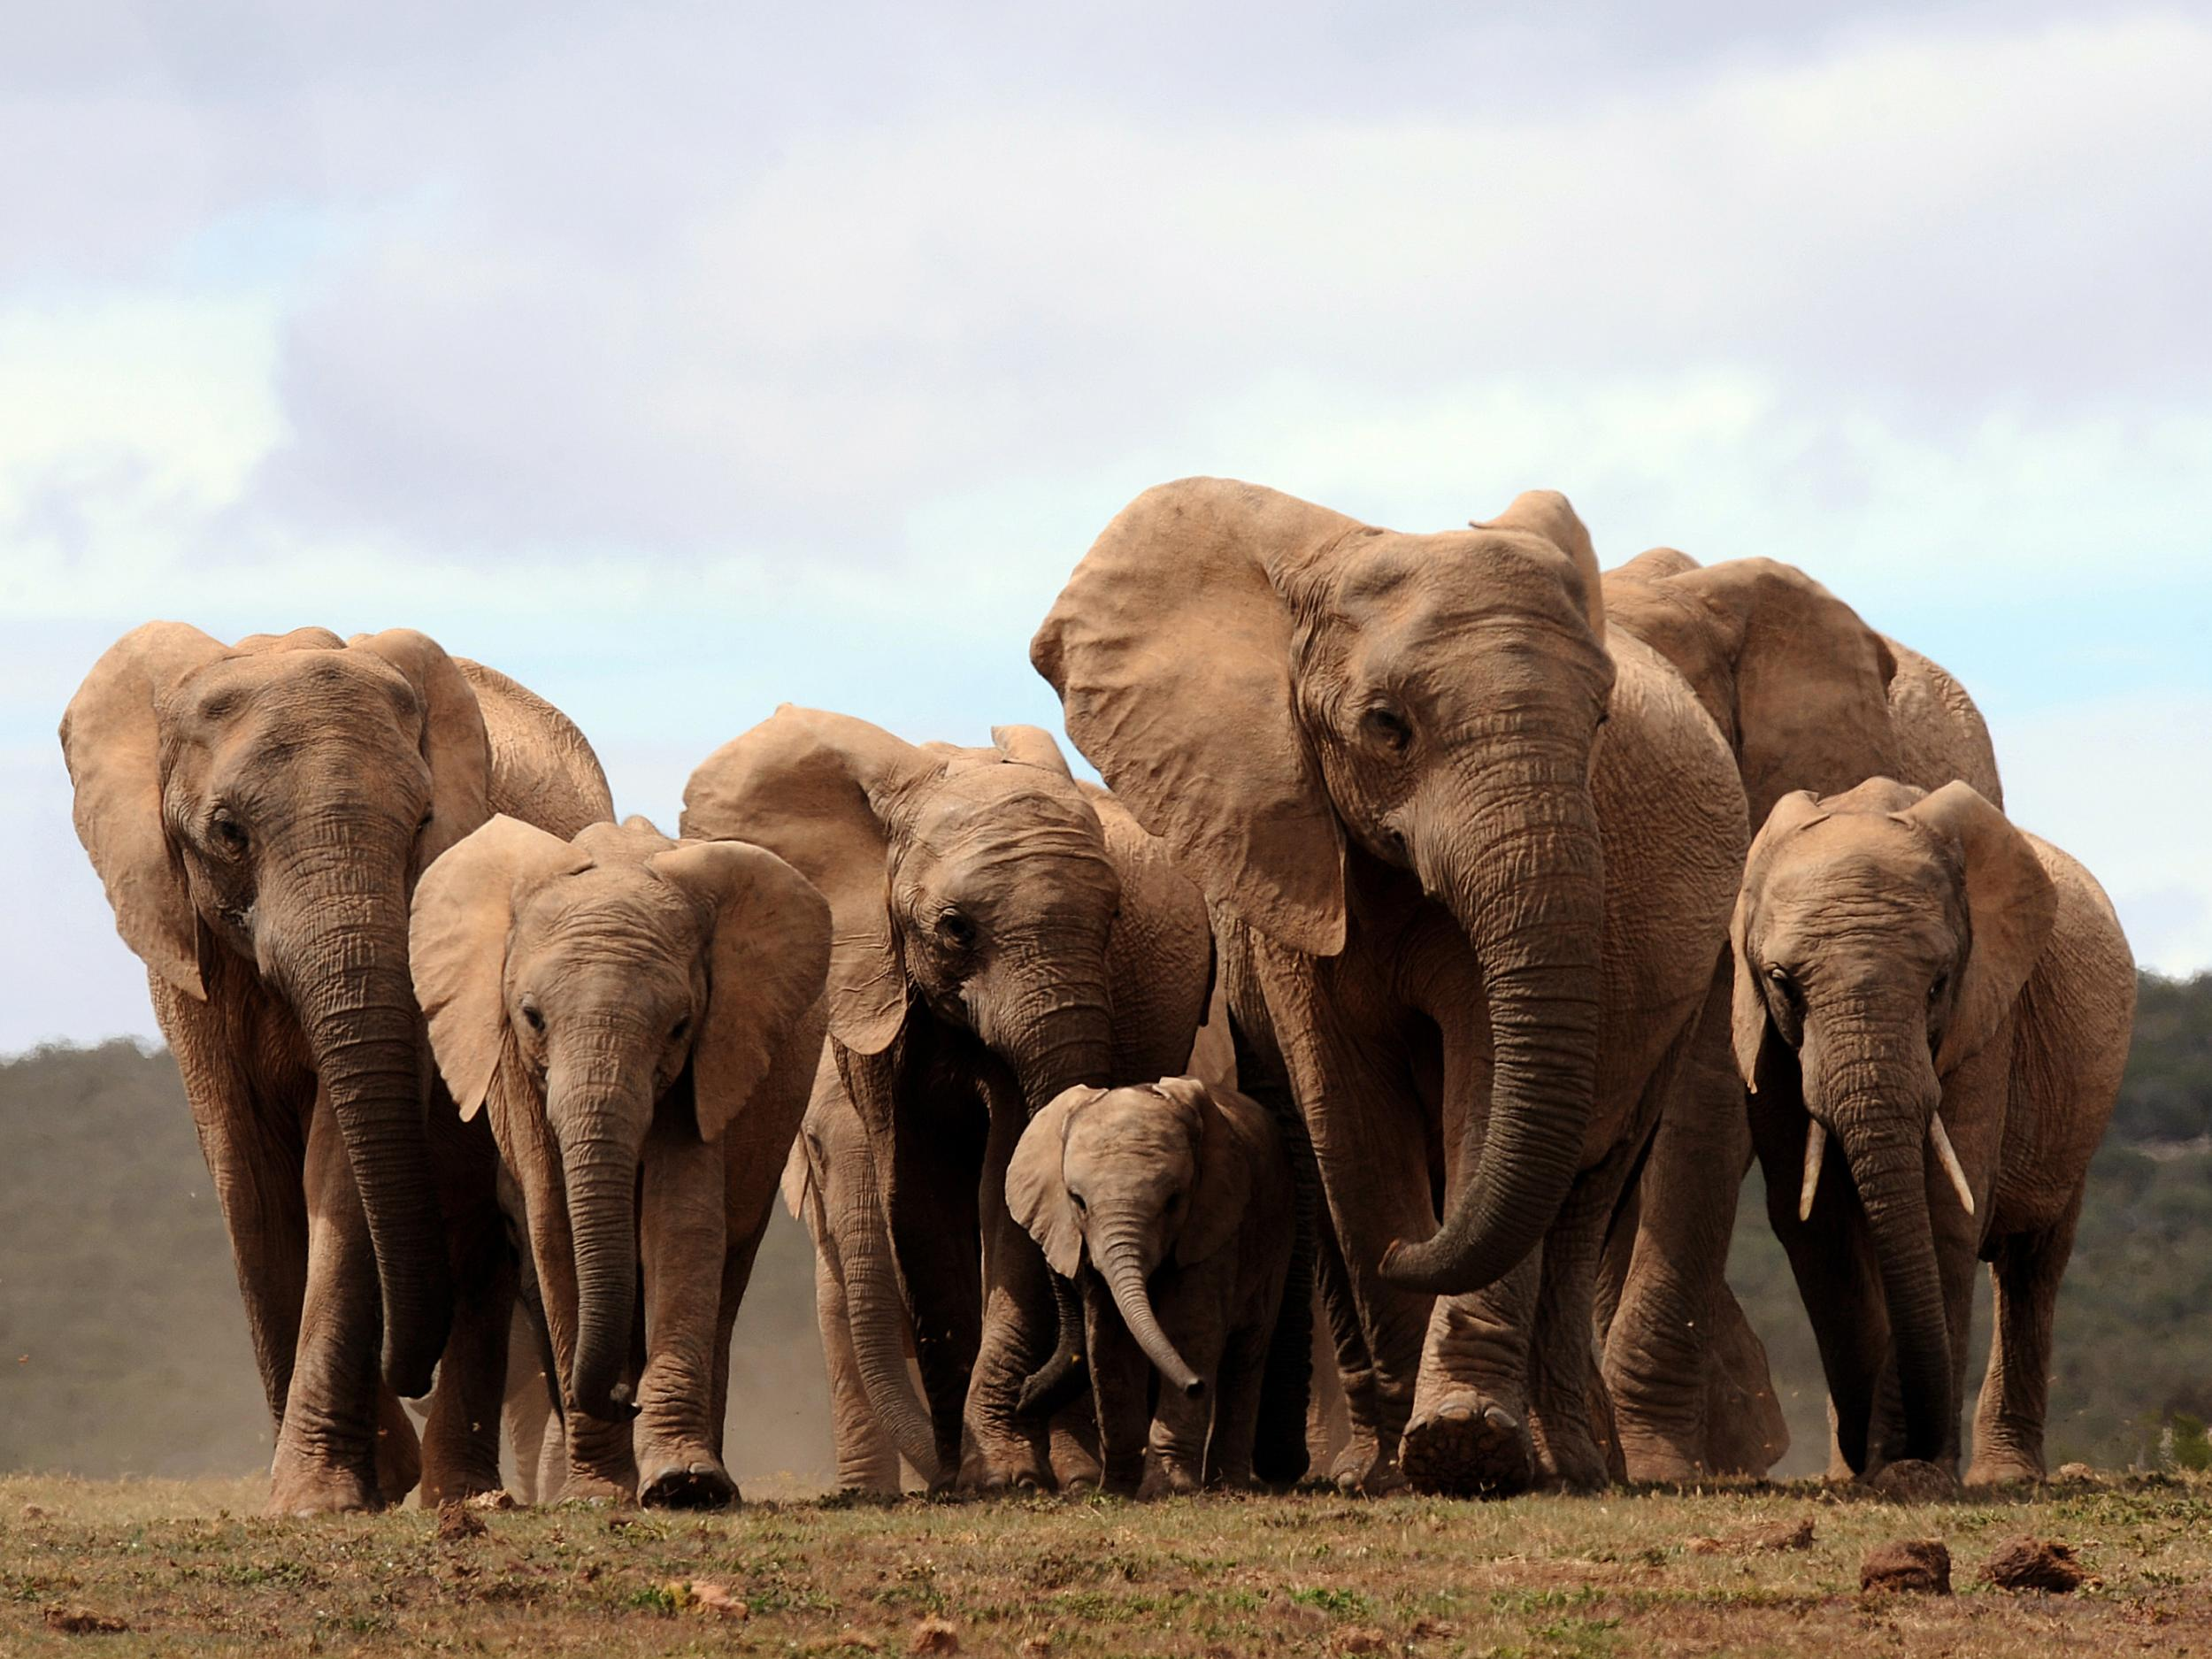

Slide 2
Recap
Hadoop installation
HDFS Java API

Slide 3
Agenda for today
MapReduce counters
Performance tuning in MapReduce jobs
MapReduce job chaining
Pig
Java programming & SQL for beginners

Slide 4
Performance tuning
Cluster configuration
Use compression technique
Tuning # mappers and reducers
Use combiner
Appropriate data type
Reuse objects
Profiling
https://blog.cloudera.com/blog/2009/12/7-tips-for-improving-mapreduce-performance/

Slide 5
MapReduce Job chaining
Two separate jobs
Multiple mappers/reducers within same job

Slide 6
MapReduce Job chaining
Two separate jobs
Configure first job object and run it.
Configure second job object and run it

Slide 7
MapReduce Job chaining
Multiple mappers/reducers within same job
ChainMapper API: to add multiple mappers
ChainReducer API: to add multiple reducers

Slide 8


Slide 9
Introduction
High Level Scripting Language developed by Yahoo originally
Transforms SQL like language called Pig Latin into Java code
Follows lazy evaluation
Supports UDF written in multiple languages

Slide 10
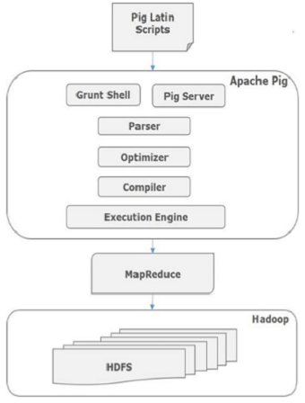
Architecture

Slide 11
Execution
Accessing approaches:
Batch mode: submit a script directly
Interactive mode: Grunt, the pig shell
PigServer for Java program
Execution mode:
Local mode: pig –x local
Mapreduce mode (default): pig –x mapreduce

Slide 12
Data types
Scalar Types: Int, long, float, double, boolean, null, chararray, bytearray
Complex Types: fields, tuples, bags, relations

Slide 13
Operator: LOAD
To load data from storage system
lines=LOAD ‘myfile’ AS (line: chararray);
books = LOAD ‘/data/pig/books.csv’ as (line: chararray)

Slide 14
Operator: DUMP
Print the data on console
DUMP RelationName;
DUMP sample_books;

Slide 15
Various loaders
Supports various loader formats
TextLoader
PigStorage
JsonLoader & JsonStorage
BinStorage
HBaseStorage
OrcStorage
MongoStorage

Slide 16
Operator: LOAD cont…
Load data without schema
relXYZ = LOAD ‘yourfile.csv' USING PigStorage(',');
books = LOAD ‘/data/pig/books.csv' USING PigStorage(',');
Load data with schema
relXYZ = LOAD ‘yourfile.csv' USING PigStorage(',') as (col1:datatype, col2:datatype,…);
books = LOAD ‘/data/pig/books.csv' USING PigStorage(',’) as (id:int, author:chararray, name:chararray, year:int);

Slide 17
Operator: LIMIT
Take sample records
New_Rel = LIMIT RelationName <Sample Count>;
Sample_books = LIMIT books 5;

Slide 18
Operator: FOREACH
Select specific columns
New_Rel = FOREACH RelationName GENERATE col1, col2, col3….;
book_no_author = FOREACH books GENERATE id, name, year;

Slide 19
Operator: JOIN
Joins two relations/datasets
join_data = JOIN relation1 BY (column1), relation2 BY (column1);
book_review = JOIN books BY (id), reviews BY (id)

Slide 20
Operator: SORT
Sort a relation based on key
New_rel = ORDER RelationName BY ColumnName asc;
books_sorted_by_year = ORDER books BY year asc;

Slide 21
Operator: FILTER
Filter the dataset
New_rel = FILTER RelationName BY (Condition);
books_before_2000 = FILTER books BY (year < 2000)

Slide 22
Operator: DISTINCT
Remove duplicates
New_rel = DISTINCT RelationName;
bedupe = DISTINCT books_before_2000;

Slide 23
Aggregate
Aggregate based on a key
GroupRel = GROUP RelName BY columnName;
group_review = group book_review by books::id;
AggRel = FOREACH GroupRel GENERATE group , AVG(columnName)
avg_rating = foreach group_review generate group as id, AVG($1.reviews::rating)

Slide 24
Operator: STORE
Store the output
STORE relationName INTO 'output_directory' USING PigStorage(',’);
STORE dedupe INTO ‘/data/pig/dedupe' USING PigStorage(',’);

Slide 25
PigServer API
import java.io.IOException;
import org.apache.pig.PigServer;
public class idlocal{
public static void main(String[] args) {
try {
PigServer pigServer = new PigServer("local");
runIdQuery(pigServer, "passwd");
}
catch(Exception e) {}
}
public static void runIdQuery(PigServer pigServer, String inputFile) throws IOException {
pigServer.registerQuery("A = load '" + inputFile + "' using PigStorage(':');");
pigServer.registerQuery("B = foreach A generate $0 as id;");
pigServer.store("B", "id.out");
}}

Slide 26
UDF
Prepare a Jar file
Register the Jar
Define alias
Use it
https://www.tutorialspoint.com/apache_pig/apache_pig_user_defined_functions.htm

Slide 27
Further reading
Map Reduce job chaining:
https://mapr.com/blog/how-to-launching-mapreduce-jobs/
Pig inbuilt functions
https://pig.apache.org/docs/latest/func.html

